Slide 1
aggression factors in dogs
Manydogs_2024 survey
Data606 project
December 3, 2025
Jessica chen

Slide 2
Abstract
This project investigates the factors that contribute to aggression in dogs using data collected from an international survey of dog guardians called the Many Dogs Project¹. The dependent variable, dog aggression, was derived from a subset of 27 aggression question responses, with summary ratings calculated to represent overall aggression score for each respondent. The dataset includes multiple independent variables, mostly categorical, encompassing aspects of the dog’s home environment, demographic characteristics, and “origin” (e.g., shelter, breeder, etc.).
A multiple regression analysis was conducted to examine the relationship between these predictors and aggression. The final model explained a moderate proportion of dog aggression (adjusted R² of ~0.2), leaving room for more explanatory variables to be captured in the future. Among the most influential predictors were elements of (1) the dog’s home environment (e.g., dogs residing in private homes vs. group settings and the number of other dogs in the home) and (2) the dog’s background (e.g., origin & breed).
Regression assumptions, including linearity, homoscedasticity, normality of residuals, and absence of multicollinearity, were assessed and found to be adequately met. The model has limitations in explanatory power and should the opportunity arise, it would be interesting to incorporate more quantitative variables.
Overall, this project provides evidence that both environmental and origin-related factors are predictors of aggression in dogs. Other interesting findings were that (i) sex and urban/rural settings did not have explanatory power and (ii) shelter dogs increased aggression in the model while rescue dogs decreased aggression score. These insights can inform guardians, trainers, and policymakers in developing strategies to manage and prevent aggressive behavior.
1. ManyDogs Project, Espinosa, J., Hare, E., Alberghina, D., Perez Valverde, B, & Stevens, J.R. (2024). Data for ManyDogs 1. Journal of Open Psychology Data. doi:10.5334/jopd.109

Slide 3
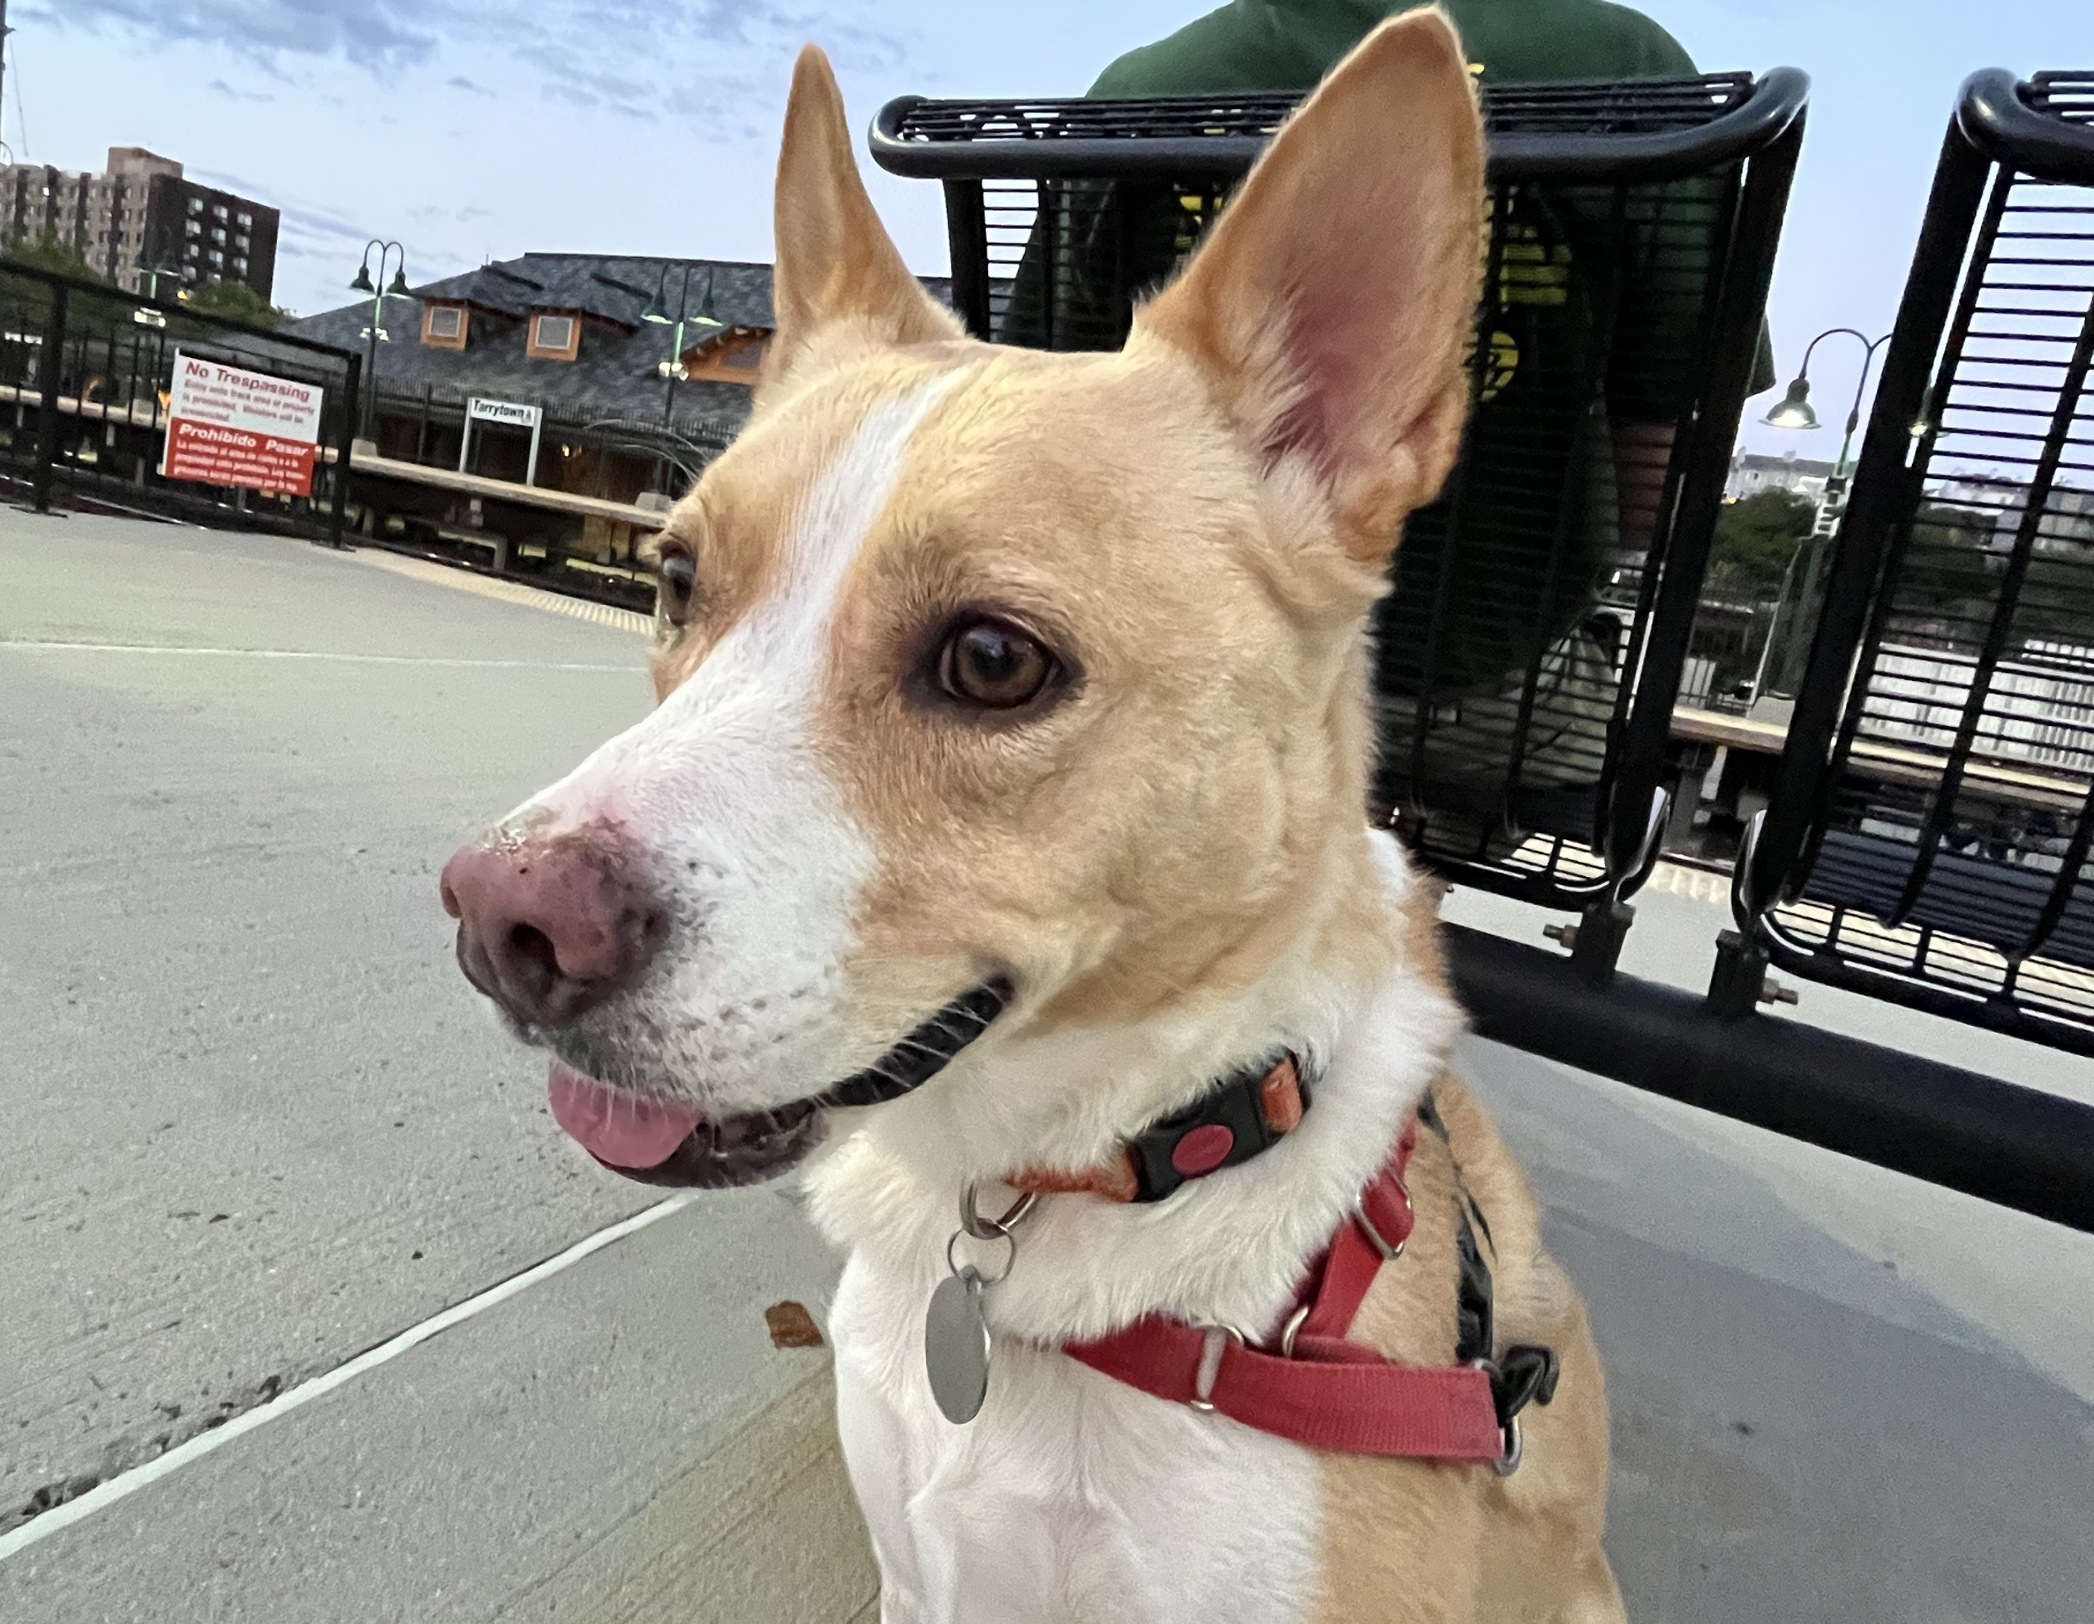
This is NOLA

Slide 4
Overview – Background data
The data for this project is collected from the Many Dogs Project^{1.}
Methodology:
Dog guardians recruited through research site databases and social media.
The guardians would complete an online survey of basic demographics & questions regarding dog temperament and behaviors. There is a second part of the research on site where the dog completes a series of behavioral tasks involving food rewards gauging their interest and behavior with and with-out ostensive communication.
This study was conducted over 13 months between January 2022 to January 2023.
There are 704 cases (studies) collected from 20 research sites across eight countries. After filtering for incomplete surveys/NAs, we are left with 155 observations which will be used.
Research is widely used – e.g., main study looked at how ostensive communication can influence dog behavior.
1. ManyDogs Project, Espinosa, J., Hare, E., Alberghina, D., Perez Valverde, B, & Stevens, J.R. (2024). Data for ManyDogs 1. Journal of Open Psychology Data. doi:10.5334/jopd.109
Notes:
Methodology: Dog guardians were recruited through research site databases and social media by "ManyDogs", an international research consortium of scientists interested in Canine behaviour. The guardians would complete an online survey of basic demographics & questions regarding dog temperament and behaviors. There is a second part of the research on site where the dog completes a series of behavioral tasks involving food rewards gauging their interest and behaviour with and with-out ostensive communication. This study was conducted over 13 months between January 2022 to January 2023.

Slide 5
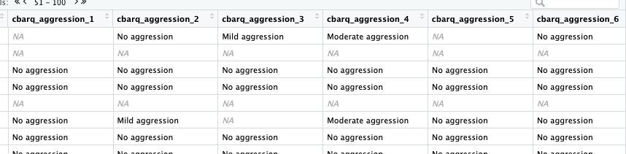
Overview – dependent variable
Dependent Variable: Aggression
27 individual aggression rating questions like “When approached directly by an unfamiliar adult while being walked/exercised on a leash”
MC possible responses:
No aggression
Not observed
Mild aggression
Moderate aggression
Serious aggression
High aggression
The aggression score was computed two ways:
Any scores moderate and above were counted as 1 and total was tallied (ie. Max score of 27)
Scores were ranked 0-3 with 3 being severe and total was tallied (ie. Max score of 3*27 = 81) **Adjusted**

Slide 6
Overview – Independent variables
Environment
Owned Status (private vs. group housing)
Sex
Age
Desexed
Pure Bred
Number of Household Dogs (1, 2… 6+)
Origin (breeder, rescue, etc.)
Guardian Gender
Research Question: Which variables can predict dog aggression?

Slide 7
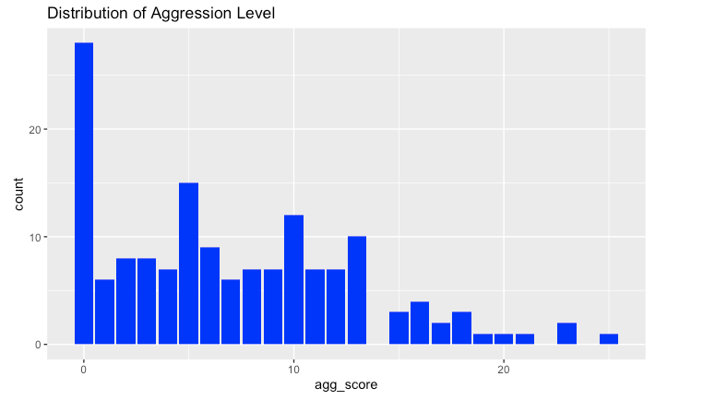
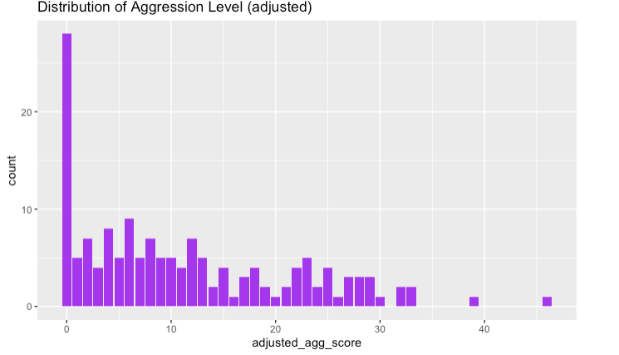
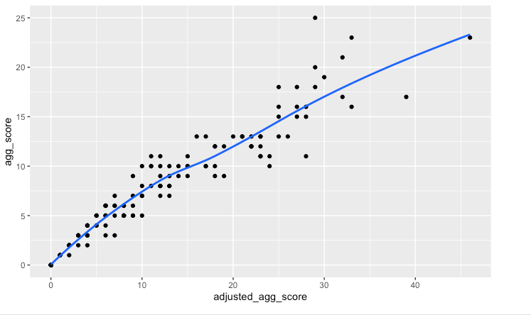


Summary statistics – dependent variable
Aggression Score vs. Adjusted Aggression Scores

Slide 8
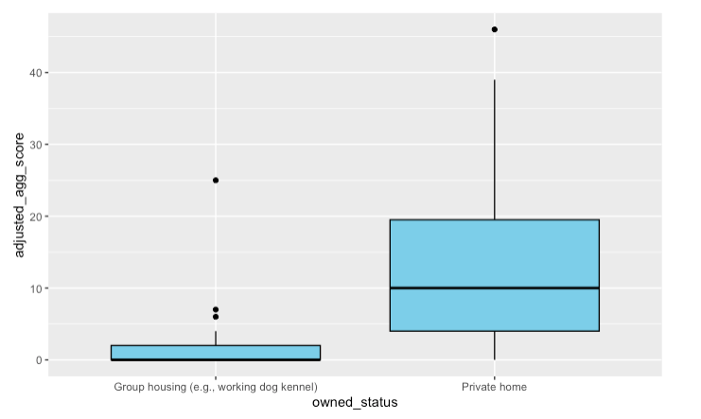
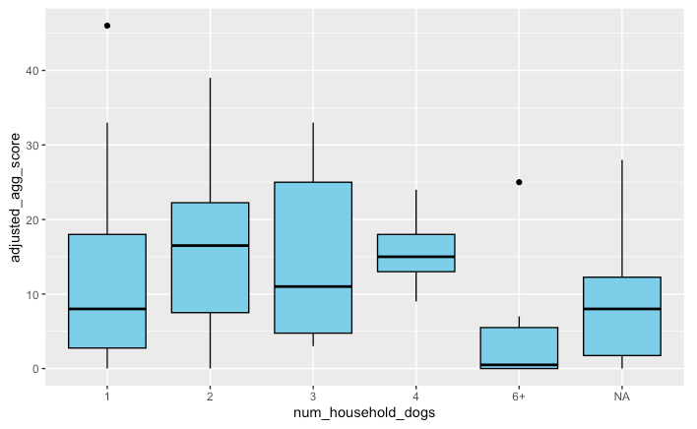
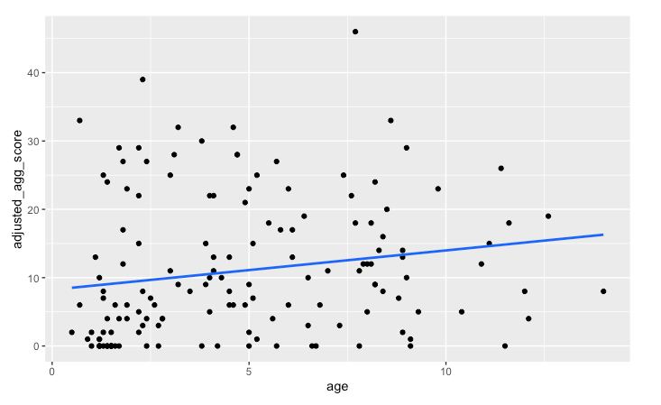
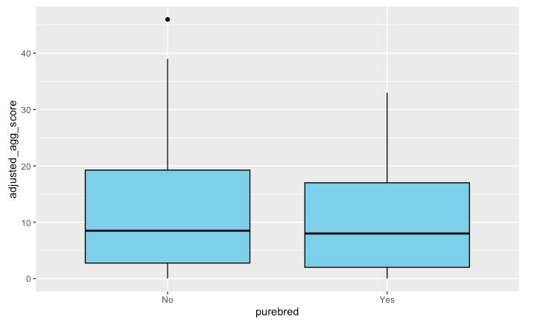
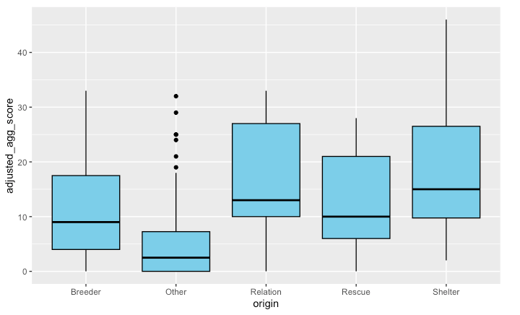
Summary statistics – independent variables
Adjusted aggression vs. Owned Status
vs. number of household dogs
vs age
vs. pure bred
vs. origin
Notes:
Interestingly, shelter are often government run and have lot of dogs where rescues are more privately run and often animals are more cared for.

Slide 9
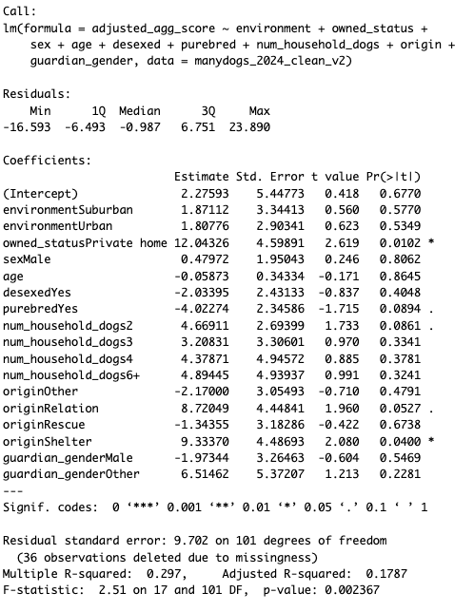
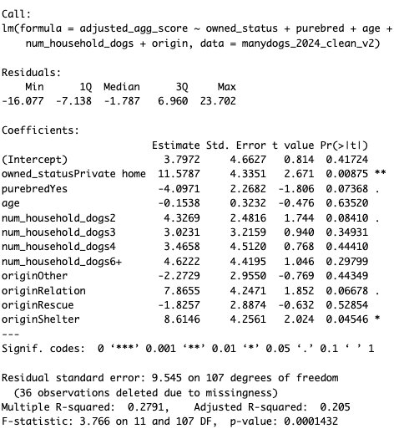
Statistical outputs – Regression Results
1. Initial (all variable) Result
2. Final result using backwards selection
Age ~0.63

Slide 10
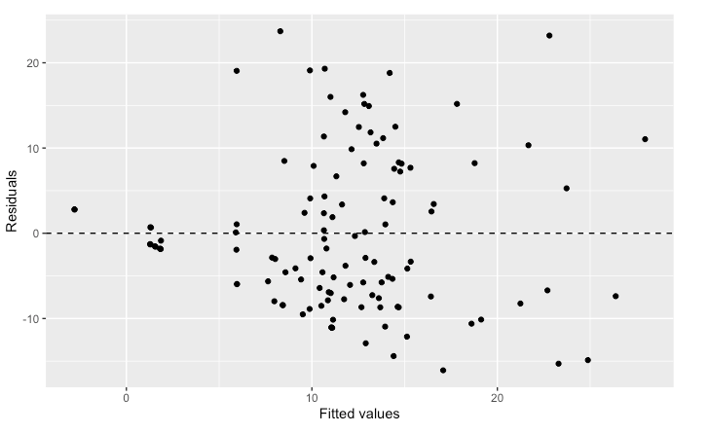
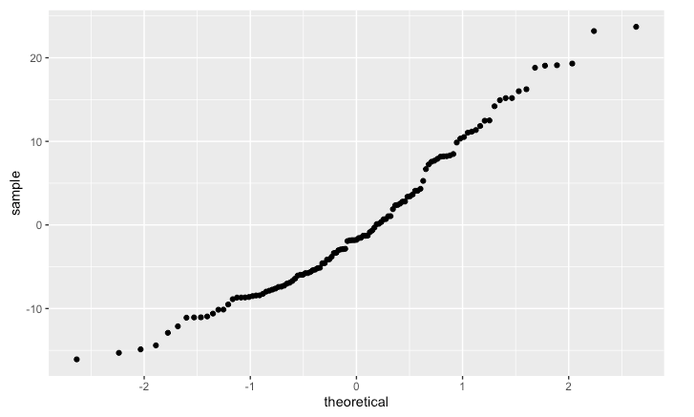
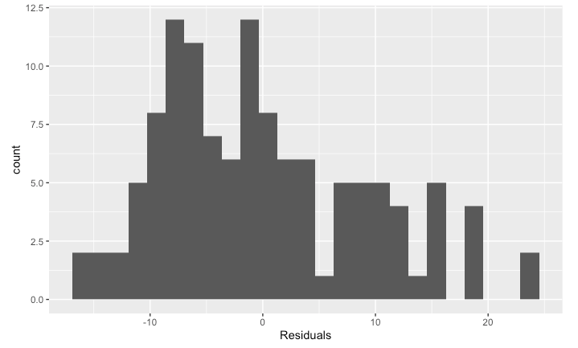
Statistical outputs – checking assumptions
#Plot 1 Residuals vs. Fitted Values
# Plot 3 Normal prob plot of residuals
^ plot looks overall randomly scattered though looks slightly wider on right.
Impact of categorical data?
# Plot 2 Distribution of residuals
< ^ residuals appear normally distributed and nearly normal.
Notes:
Plot 1 – variability of residuals are constant and equally spread
Plot 2&3- residuals are nearly normal around 0

Slide 11
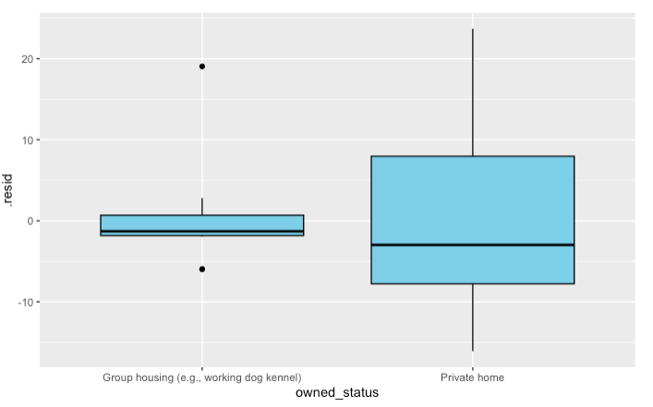
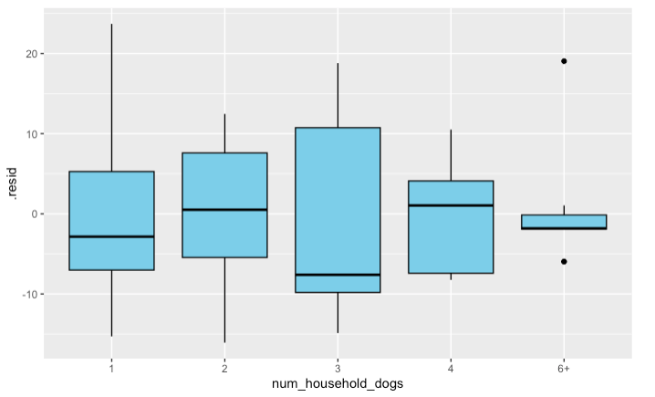
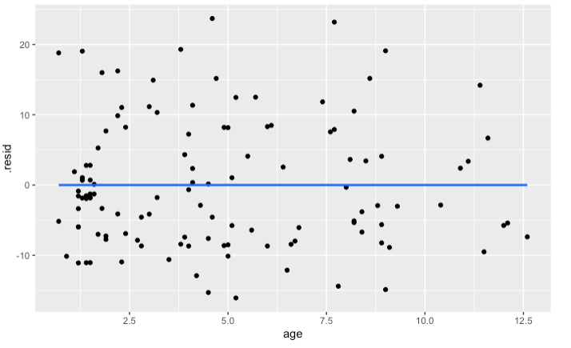
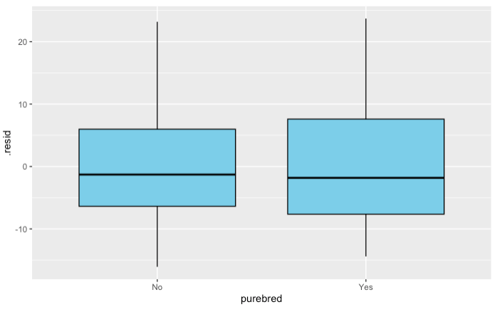
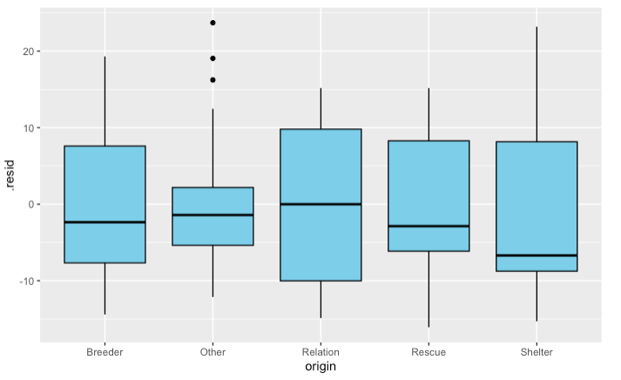
Statistical outputs – checking assumptions
Residuals vs. Owned Status
vs. number of household dogs
vs. age
vs. pure bred
vs. origin
Notes:
Checking for linear relationship related to the outcome. We see this for age, for other variables which are categorical, I checked that variability does not fluctuate across groups.

Slide 12
Statistical outputs – ANOVA Tables
Number of household dogs
Null hypothesis that there are no significant difference in mean across groups.
Review of ANOVA tables showed as expected – Number of household dogs, owned status and origin had significant P values to reject the null hypothesis in favor of the alternative that at least one group mean differs.
Age was found to be significant which prompted for inclusion into regression.
Df Sum Sq Mean Sq F value Pr(>F)
num_household_dogs 4 950 237.4 2.187 0.0745 .
Residuals 118 12808 108.5
Df Sum Sq Mean Sq F value Pr(>F)
owned_status 1 1742 1741.9 18.82 2.59e-05 ***
Residuals 153 14157 92.5
Df Sum Sq Mean Sq F value Pr(>F)
origin 4 1809 452.1 4.813 0.00111 **
Residuals 150 14091 93.9
Df Sum Sq Mean Sq F value Pr(>F)
age 1 509 509.3 4.982 0.0271 *
Residuals 148 15130 102.2
Owned Status
Origin
Age
Purebred
Df Sum Sq Mean Sq F value Pr(>F)
purebred 1 40 40.14 0.387 0.535
Residuals 153 15859 103.65
Notes:
model <- aov(adjusted_agg_score ~ num_household_dogs, data = manydogs_2024_clean_v2)
summary(model)

Slide 13
Statistical outputs – ANOVA Tables
Interestingly no interaction effects were found between variables
Accept null hypothesis there is no mean diff between urban, suburban and rural
Environment & household dogs
Df Sum Sq Mean Sq F value Pr(>F)
environment 2 165 82.44 0.743 0.478
num_household_dogs 4 870 217.53 1.959 0.106
environment:num_household_dogs 6 510 85.05 0.766 0.598
Residuals 110 12213 111.02
32 observations deleted due to missingness
Df Sum Sq Mean Sq F value Pr(>F)
owned_status 1 1953 1953.2 19.788 2e-05 ***
num_household_dogs 4 326 81.6 0.827 0.511
owned_status:num_household_dogs 1 28 28.4 0.288 0.593
Residuals 116 11450 98.7
Owned status & household dogs
Environment
Df Sum Sq Mean Sq F value Pr(>F)
environment 2 72 36.13 0.347 0.707
Residuals 152 15827 104.12

Slide 14
Conclusion – Final regression model
Aggression score equation = 3.7972 (intercept)
+ 11.5787 * owned_status (where private home = 1, group housing = 0)
- 4.0971 * purebred (where yes = 1, otherwise 0)
- 0.1538 * age
+ 4.3269 * num_household_dogs(2)
+ 3.0231 * num_household_dogs(3)
+ 3.4658 * num_household_dogs(4)
+ 4.6222 * num_household_dogs(6+)
- 2.2729 * origin(Other)
+ 7.8655 * origin(Relation)
- 1.8257 * origin(Rescue)
+ 8.6146* origin(Shelter)
1
2
3
4
5
Dogs in private home settings that have more than 1 dog, non purebreds and are either from “relations” or shelter are more likely to be aggressive.
Furthermore, aggression declines slightly with age.
Note: num_household_dogs 1 is default; for origin, breeder is the default

Slide 15
Conclusion – Final thoughts & Takeaways
Data clean up takes longer than one would think! (and it’s a shame to waste collected data that have one or two NAs)
Dogs in private home settings that have more than one dog, non purebreds and either from “relations” or shelter are more likely to be aggressive. Furthermore, aggression declines slightly with age.
Some of the results make intuitive sense (e.g., aggression declines slightly with age, shelter dogs more likely to be aggressive)
Interestingly, I learned the diff between “shelters” and “rescues” and shelters add to aggression score while rescue decreases it. (Could be explained that shelters can house a lot of dogs and be overrun)
With more dogs, it’s possible that the chance of reaction capturing is higher
Some ambiguity with survey answers (e.g. how is urban, suburban vs. rural defined?)
With adjusted R² of ~0.2, there are a lot of other factors the current model does not capture.
Would more continuous quantitative variables result in better model?
Adjusted aggression score had slight higher explanatory results, perhaps because the results can be better defined with more range.
Initial curiosity if “environment” (urban vs. rural) impacts aggression was answered and more.

Slide 16
Thank you!

